Slide 1

KLSE: SAMAIDEN
Bursa Category: Construction & Engineering

Slide 2
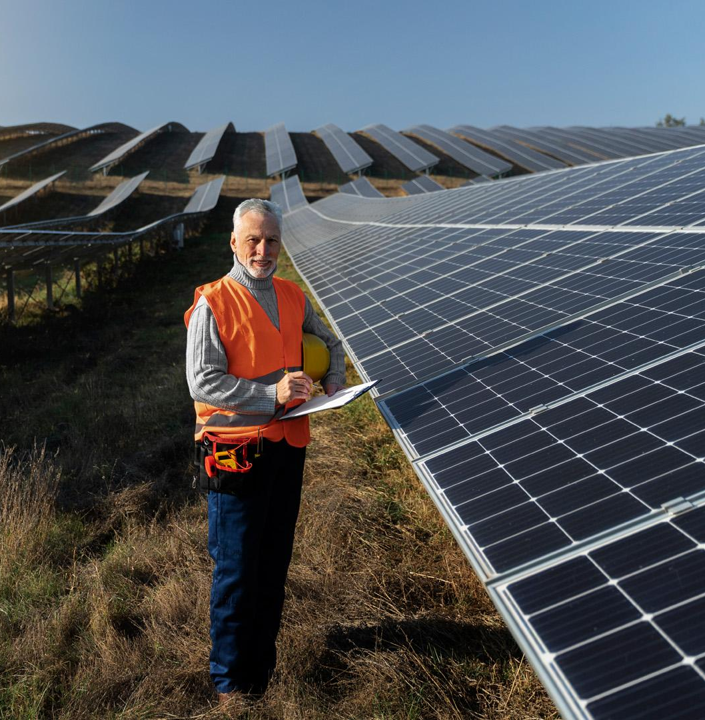
This company is a
Renewable energy (RE) solution provider
Engineering
Procurement
Construction
Commissioning (EPCC) of solar photovoltaic (PV) systems and power plants
RE and environmental consulting services

Slide 3
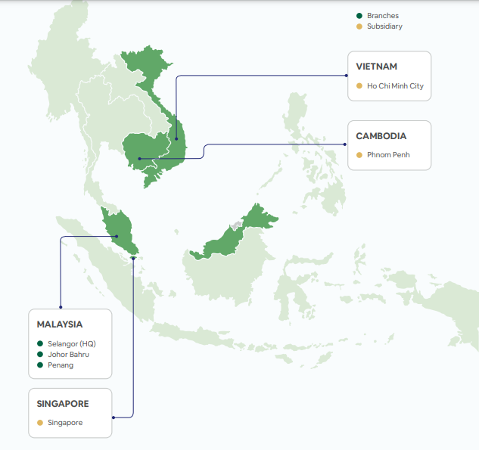

Slide 4
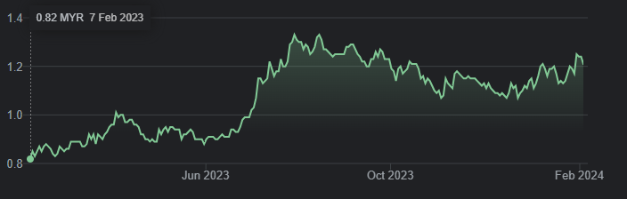
7 February 2023 : RM 0.82 per share
5 February 2024: RM 1.21 per share

Slide 5
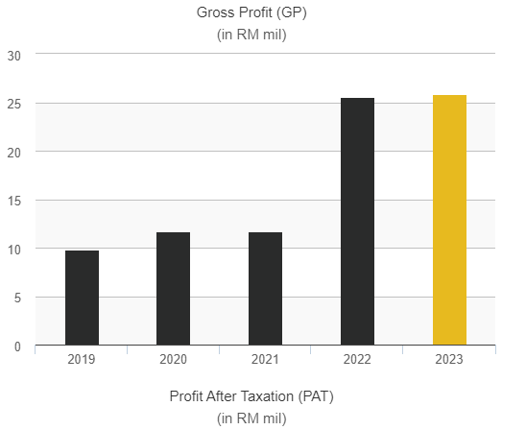

Slide 6
Aspects
Return on Equity(Net Profit after Tax / Shareholder Equity)
2021 2022 2023
0.12 0.14 0.10
Debt Equity Ratio
2021 2022 2023
0.05 0.18 0.10
Net Profit Margin(Net Profit/Revenue)
2021 2022 2023
0.111 0.079 0.059

Slide 7

EPS Growth
2020 2021 2022 2023
(0.65) 0.88 (0.19)
Price Earning Ratio

Slide 8
No Fixed Dividend Policy

Slide 9
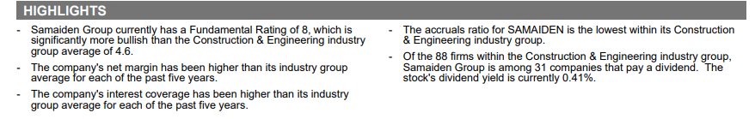
Extracted Bursa Marketplace Stock Report(Sep 2023)

Slide 10
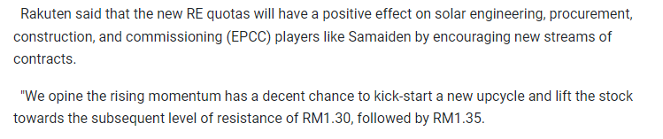
Extracted from Online News Article

Slide 11
Thanks!

