Slide 1

KLSE: BAUTO
BURSA CATEGORY: CONSUMER PRODUCTS & SERVICES

Slide 2
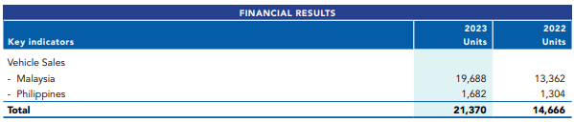
BUSINESS ACTIVITY
Bermaz Auto is involved in the distribution, assembly, retail of Mazda vehicles in Malaysia, as well as the provision of after-sales services.
It is also involved in the domestic distribution and export of locally assembled Mazda vehicles. Its subsidiary, Bermaz Auto Philippines, distributes Mazda vehicles in the Philippines.

Slide 3
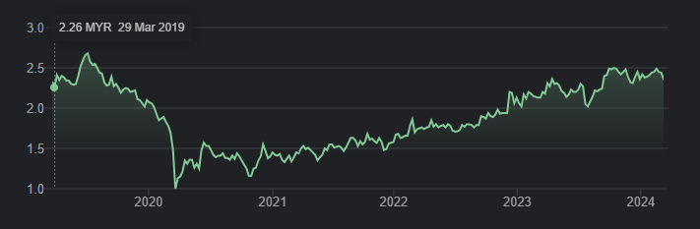
5 Year Share Price Graph

Slide 4
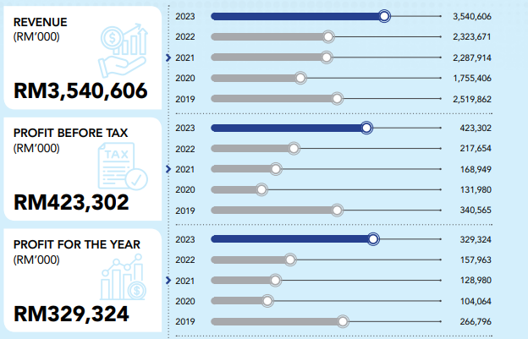
Extracted from Annual Report 2023

Slide 5
Return on Equity(Net Profit after Tax / Shareholder Equity)
2020 2021 2022 2023
0.22 0.23 0.25 0.43
Dividend Payout (%)
2021 2022 2023
56.5% 65.7% 84.6%
EBIT Margin
2022 2023 2024F 2025F
8.77 9.27 11.09 11.09

Slide 6
EPS Growth
2020 2021 2022 2023
0.33 0.16 0.97 0.95
Price Earning Ratio
2022 2023 2024F 2025F
14.9 8.8 8.1 8.3

Slide 7
Thank You

