Slide 1


MAGNI-TECH INDUSTRIES BERHAD (KLSE: MAGNI)
Researcher: Handzalah
Date: August 12th, 2024

Slide 2
Company Background
Incorporated in Malaysia on 12 March 1997
Listed on second board of Bursa Malaysia Securities Berhad on 18 April 2000
Transferred to main board on 8 April 2003
Tan Sri Dato’ Tan Kok Ping (CEO)
Tan Poay Seng (managing director)
Initially in the packaging business but then diversified into the garments business after acquiring SIG on 1 November 2006

Slide 3
Business Overview
Manufacturer of flexible plastics, corrugated packaging and garments
Garment’s segment grew from 76.2% of revenue in 2009 to 91.81% in 2023
The large growth in garment can be attributed to one major customer making up 88.04% of revenue in 2023
Business revenue are also dependent of foreign exchange gains and losses
The packaging segment is deemed “recession proof”
Ceased its offset printing packaging business before fiscal year end 2018

Slide 4
Qualitative Analysis
No dividend policy but management targets a payout ratio under around 40%
Management ownership in shares exceeds external shareholders as of current
Management’s ability to grow revenue year over year with the use of debt for around 10 years
Management’s adherence to Shariah compliance status for 15+ consecutive years (since 2008)
Management’s risk mitigation measures in foreign exchange hedging
No dilutive options

Slide 5
Quantitative Analysis
At market price of RM 2.32 per share, net current asset covers 81.47% of market price at NCAVPS of RM 1.89
Through a DCF valuation, intrinsic value came to RM 4.67 assuming modest growth
Median 10-year ROIC around 28%
10-year revenue CAGR amounting to 7.5%
No debt in 10 years except for operating leases during the earlier years
Median 10-year reinvestment rate of around 20%
Dividend payout ratio rarely exceeds 40%
CEO and managing director holds a total of 49.88% of outstanding shares

Slide 6
Annual General Meeting FY22-FY23
  The major customer has been a long-term partner of Magni for over 35 years
  The reason for a resolution on issuing shares is because they want to have a mandate in place
  The reason to hold on a lot of cash is due to global economic uncertainties but management are still looking for investments and business opportunities
  Management is trying to get new brand contracts but to no material effect

Slide 7
Investment Thesis
  Due to the coverage of net current asset to market value, it makes potentially MAGNI a low-risk investment and have a payoff asymmetry (Mohnish Pabrai’s concept of heads I win, tails I don’t lose much)
  Substantial risk arising from one major customer, but it’s mitigated by the long business relationship (over 35 years)
  Although packaging is a small portion of revenue, they provide recession proofing
  Management has majority of outstanding shares signaling confidence
  Assuming a low rate of revenue growth the fair value doubles to current share price
  Foreign exchange gains and losses mitigated through natural hedges and through forex adjustment programs from customer
  Mandate that doesn’t allow Magni to issue shares greater than 10% of issued shares less treasury shares
  No dilutive options
  Growth without external funding for 10 years

Slide 8
Risks
  Customer concentration
  Foreign exchange
  Higher labor cost arising from increasing Vietnamese minimum wage
  Higher input cost arising from inflationary pressures
  If management do intend to use the cash for investments or business opportunities and those fail, substantial net current asset value per share may drop
  Other normal risks associated with a business

Slide 9
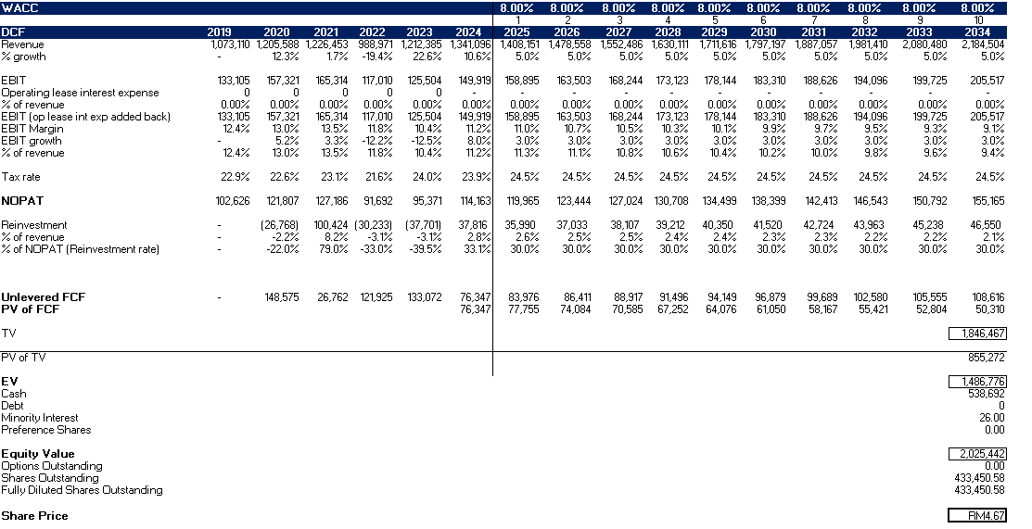
DCF

Slide 10
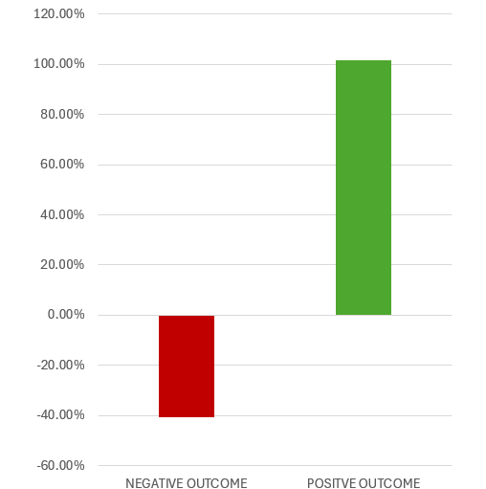
Probable Payoff Asymmetry
  Positive outcome : 5% growth in revenue for the next 10 years (+101.40%)
  Negative outcome: Lose all revenue arising from one major customer and having reinvestments eat away net current assets for 10 years (-40.52%)

Slide 11
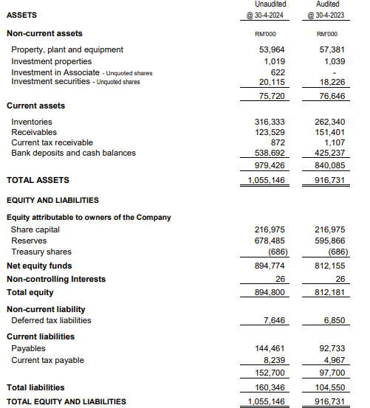




NCAVPS
  NCAVPS = Current Assets – Total liabilities – NCI
  Total outstanding shares
  → (979426-160346-26) / 433450.579
  = RM 1.89 per share

Slide 12
Probable Value Floor
  Median Reinvestment rate over 10 years is RM 22 130 000
  Multiplying the reinvestments by 10 years will give us RM 221 300 000, this is the 10 years of reinvestment
  Subtracting the 10 years of reinvestment from the NCA (RM 819 054 000) gives us RM 597 754 000 or RM 1.38 per share (59.48% of market value)

